Slide 1
GIT
May 2014

Slide 2
Agenda
About Git
Commands
Git Remote
Rebase
Config
Stashing
Cherry-pick
Reflog
Create GitHub Account and Install GitHub for Windows
GitHub for Windows

Slide 3
About Git

Slide 4
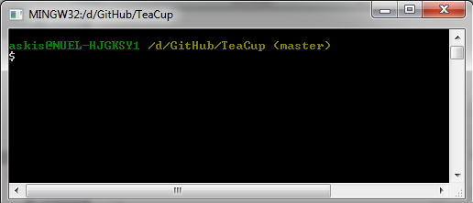
About
Git is a DISTRIBUTED VERSION CONTROL SYSTEM (DVCS)
Linux Kernel project
Distributed and fast
Can handle large projects
Betriebssystem
Linux and other Unixoide Systems
Microsoft Windows
Lizenz: GNU GPLv2
Written in C, Bourne-Shell, Perl
Command line interface
Many GUI tools available
Official Git Site: http://git-scm.com/

Slide 5
Commands

Slide 6
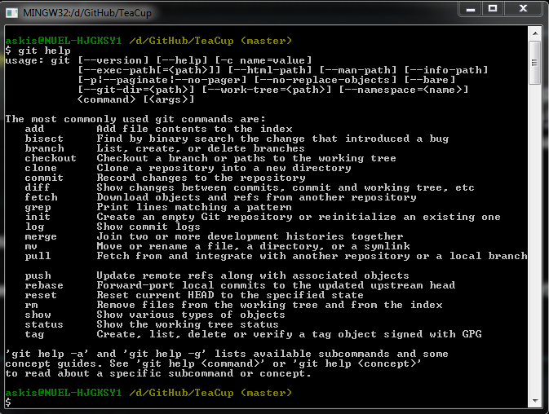
Command „git help“

Slide 7

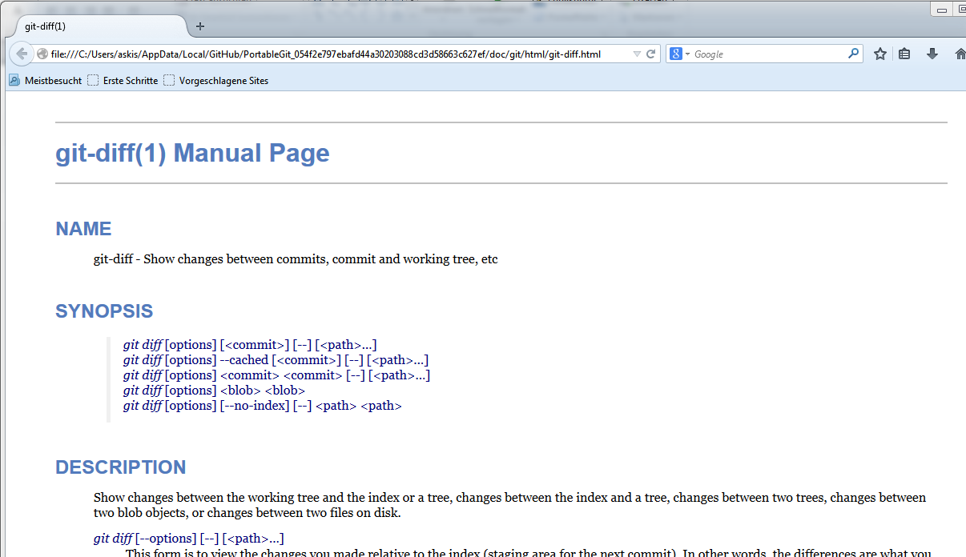
Command „git help <command>“

Slide 8
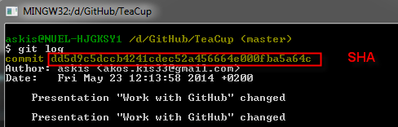
Commands
„git init“: initialize an empty Git repository
„git status“: check what‘s changed since last commit
„git add <filename>“: adds a file to reportsitory
„git add -all“: adds all new or modified files
„git commit –m „<comment>““: commit with message
„git commit –amend –m „<new message>““: change last commit
„git log“: commit history
„git diff“: shows unstaged differences since last commit
„git reset –soft HEAD^“: undo last commit, put changes into staging
„git reset –hard HEAD^^“: undo last 2 commits and all changes

Slide 9
Git Remote

Slide 10
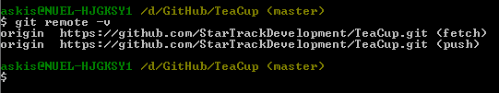
Add, push, pull, remove a remote
„git remote add origin <github https address>“: creates a new remote on GitHub
„git remote -v“: shows remote repositories
„git push –u origin master“: pushes a local branch to remote repository
„git pull“: pulls changes from remote reportsitory
„git remote rm <name>“: remove a remote reportsitory
Notes:
10
10

Slide 11
Cloning, branching out, merging a repository
„git clone <url for remote reportsitory> <optional local folder name>“: clones a remote repository, local folder name is only used when we the local reportsitory name is different
Clone steps
Download the entire repository into a new git-real directory
Adds the ‚origin‘ remote, pointing it to the clone URL
Checks out initial branch
„git branch <branch name>“: creates a branch from master
„git chaeckout <branch name>“: switch to branch
„git merge <branch name>“: merges <branch name> to the branch where we are
„git merge <branch name1>/<branch name2>“: merges <branch nam1> to <branch name2>
„git branch –D <branch name>“: removes a branch
Merge conflicts: an editor pops up
Notes:
11
11

Slide 12
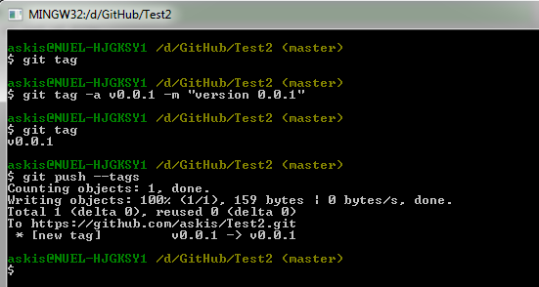
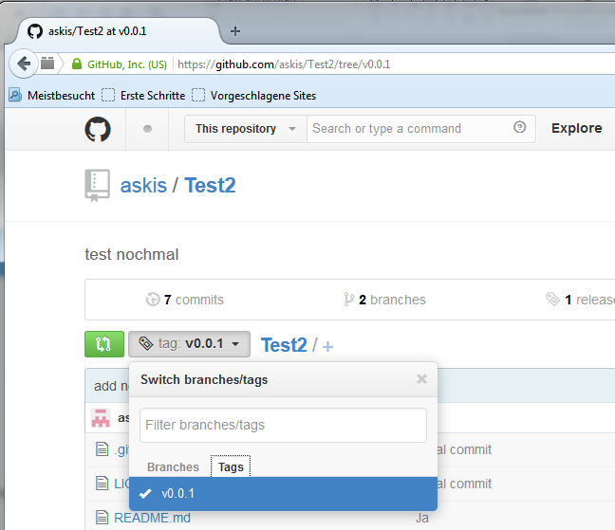
Tagging
„git tag“: tag is a reference to a commit (release versioning)
„git checkout v0.0.1“: checks out the code with version 0.0.1
„git tag –a v0.0.2 –m „version 0.0.2““: adds a new tag
„git push –tags“: pushes tag changes to remote repository
Notes:
12
12

Slide 13
Rebase

Slide 14
Rebase
Workflow for „git rebase“
Move all changes to master (local repository) which are not in origin/master (remote repository) to a temporary area
Run all origin/master commits
Run all commits in the temporary area, one at a time
„git rebase --continue“: continue rebase (one step for one commit)

Slide 15
Config

Slide 16


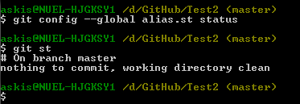
Settings
Global („git config –global …“)
User settings
set username
set email
Other settings
use notepad for interactive commands
use opendiff for merging conflicts
Aliases
Aliases checkout command
Local („git config …“)
set another email only for local repository

Slide 17
Stashing

Slide 18
Stashing
Saves the work that are not done (continue later)
Stashed change appears not in „git status“
„git stash save“: stashes the changes
„git stash list“: list of stashes (multiple stashes are allowed)
„git stash apply stash@{i}“: brings the i-th stashed files from the stash stack back (n is zero based 0..i)
„git stats pop“: brings the first stashes files back (equal to „git stash apply stash@{0}“)
„git stash drop <optional: stash@{i}>“: deletes the stash
„git stash show stash@{i}“: shows the stashed files in the i-th stash
„git stash clear“: clears the stash stack
Conflicts are possible when applying stashes
„git reset –hard HEAD“: commit or reset the local changes and then apply the stash again

Slide 19
Cherry-Pick

Slide 20
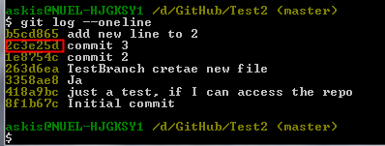



Cherry-Pick
Choose a commit and change it
Workflow
choose a log id you want to change „git log --oneline“
cherry-pick the commit
Commit or abort cherry-pick

Slide 21
Reflog

Slide 22
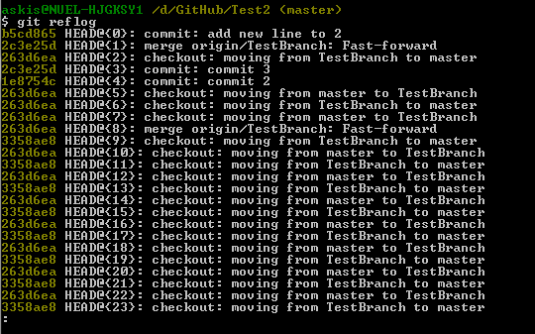
Reflog
Shows all changes to find lost data
Git updates the reflog when the HEAD moves (commit, branch, reset)
You can reset the commit: „git reset –hard <commit id or HEAD@{i}>“: i is the commit index (zero based)
Deleted branches can be reseted too: „git branch <branch name> <SHA or HEAD@{i}>“

Slide 23
discussion

